Slide 1
Remember the Word
LA3942, Uva1401
Time: 3 seconds

Slide 2
Problem Descriptions(1/2)
Neal is very curious about combinatorial problems, and now here comes a problem about words. Knowing that Ray has a photographic memory and this may not trouble him, Neal gives it to Jiejie. Since Jiejie can’t remember numbers clearly, he just uses sticks to help himself.

Slide 3
Problem Descriptions(2/2)
Allowing for Jiejie’s only 20071027 sticks, he can only record the remainders of the numbers divided by total amount of sticks.
The problem is as follows: a word needs to be divided into small pieces in such a way that each piece is from some given set of words.
Given a word and the set of words, Jiejie should calculate the number of ways the given word can be divided, using the words in the set.

Slide 4
Input
The input file contains multiple test cases.
For each test case: the first line contains the given word whose length is no more than 300000.
The second line contains an integer S, 1 ≤ S ≤ 4000.
Each of the following S lines contains one word from the set. Each word will be at most 100 characters long. There will be no two identical words and all letters in the words will be lowercase.
There is a blank line between consecutive test cases. You should proceed to the end of file.

Slide 5
Output
For each test case, output the number, as described above, from the task description modulo 20071027.

Slide 6
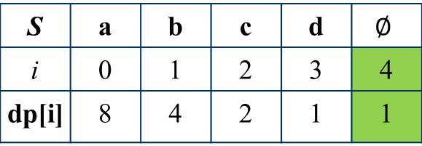
Sample Input / Output
abcd
4
a
b
cd
ab
Case 1: 2
A given word
Number of word in word set
abcd=a+b+cd
=ab+cd
S | a | b | c | d | $$∅$$
i | 0 | 1 | 2 | 3 | 4
dp[i] | 8 | 4 | 2 | 1 | 1

Slide 7

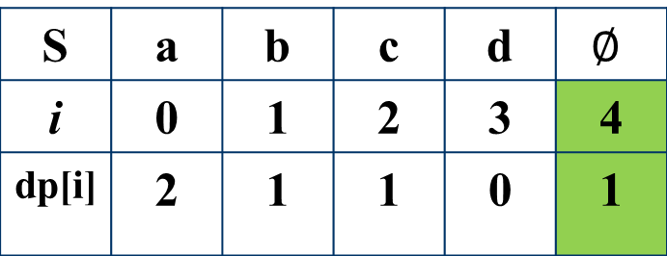
State Definition
$$dp\left[i\right]:Combination number of$$
$suffix of String S,$S[i..N-1]
Word Set:
{a, b, cd, ab}
S | a | b | c | d | $$∅$$
i | 0 | 1 | 2 | 3 | 4
dp[i] | 2 | 1 | 1 | 0 | 1
{c d}

Slide 8
State Definition
$$dp\left[i\right]:Combination number of$$
$suffix of String S,$S[i..N-1]
Word Set:
{a, b, cd, ab}
S | a | b | c | d | $$∅$$
i | 0 | 1 | 2 | 3 | 4
dp[i] | 2 | 1 | 1 | 0 | 1
{b}+{c d}

Slide 9
State Definition
$$dp\left[i\right]:Combination number of$$
$suffix of String S,$S[i..N-1]
Word Set:
{a, b, cd, ab}
S | a | b | c | d | $$∅$$
i | 0 | 1 | 2 | 3 | 4
dp[i] | 2 | 1 | 1 | 0 | 1
{a}+{b}+{c d}
{a b}+{c d}

Slide 10
State Definition
$$dp\left[i\right]:Combination number of$$
$suffix of String S,$S[i..N-1]
Word Set:
{a, b, cd, ab}
S | a | b | c | d | $$∅$$
i | 0 | 1 | 2 | 3 | 4
dp[i] | 2 | 1 | 1 | 0 | 1
{a}+{b}+{c d}
{a b}+{c d}

Slide 11
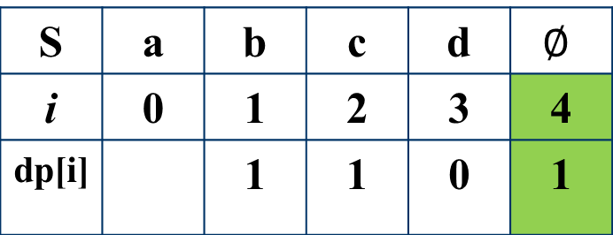
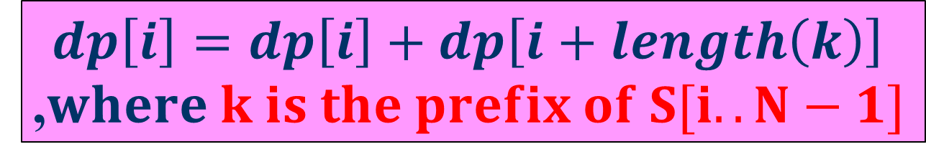
Calculation
Word Set:
{a, b, cd, ab}
從N-1 到 0 計算
S | a | b | c | d | $$∅$$
i | 0 | 1 | 2 | 3 | 4
dp[i] |  | 1 | 1 | 0 | 1
①
②
①
Prefix {a}
dp[0]=dp[0]+dp[1]
{a}+{b c d}
②
Prefix {a b}
dp[0]=dp[0]+dp[2]
{a b}+{c d}
$$dp\left[i\right]=dp\left[i\right]+dp\left[i+length\left(k\right)\right]$$
,$where k is the prefix of S[i..N−1]$

Slide 12
Solution 1
Check whether each word in the word set is the prefix of S?
There maybe 4000 words in the word set.
Beyond the time limit.

Slide 13
Solution 2
Check each prefix of S and check whether this prefix is in the word set.
How to construct an efficient data structure to fast check?

Slide 14
Trie (Prefix Tree)
Word set {a, b, cd, ab}
a
0
c
a
b
1
3
d
b
2
b
4
5
cd
ab

Slide 15
How to implement Trie?
a
0
c
a
val
ch
26 letters
b
1
3
d
b
2
0 | root
1 | 1
2 | 1
3 | 0
4 | 2
5 | 2
a b c d e f g
b
4
 | 0 | 1 | 2 | 3 | 4 | 5 | 6 | …
0 | 1 | 2 | 3
1 |  | 5
2
3 |  |  |  | 4
…
5
cd
ab
Maximum
number of node

Slide 16
Example
Word Set:
{a, b, cd, ab}
dp | a | b | c | d
i | 0 | 1 | 2 | 3 | 4
d[i] |  |  |  | 0 | 1
dp | a | b | c | d
i | 0 | 1 | 2 | 3 | 4
d[i] |  | 1 | 1 | 0 | 1
dp | a | b | c | d
i | 0 | 1 | 2 | 3 | 4
d[i] |  |  | 1 | 0 | 1
dp | a | b | c | d
i | 0 | 1 | 2 | 3 | 4
d[i] | 2 | 1 | 1 | 0 | 1

Slide 17
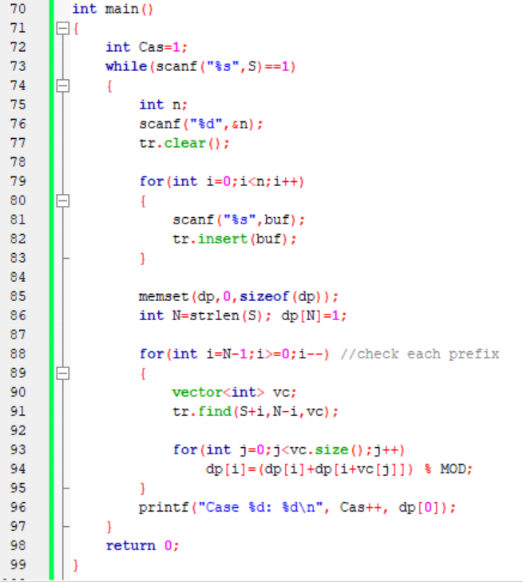
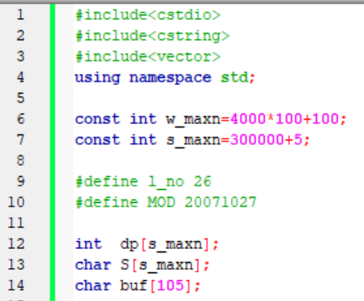

Slide 18
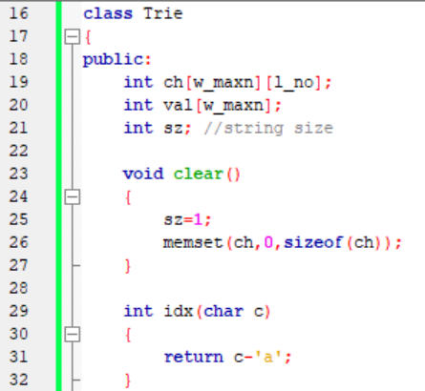
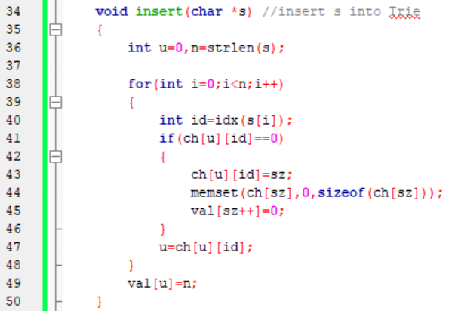

Slide 19
